Slide 1

Smart Recipe Generator
Team: Tri Techies
Saran S • Sathya R V • Tharun Pranav T

Slide 2

The Challenge We're Solving
The Problem
People often struggle to decide what to cook with available ingredients, leading to food waste and repetitive meals.
Our Solution
An AI-powered application that transforms your available ingredients into creative, personalized recipe suggestions instantly.

Slide 3


Technology Stack
Streamlit
Google Gemini API
Python
Frontend framework providing an intuitive, interactive user interface for seamless recipe discovery
Advanced AI engine powering intelligent recipe generation with creative cooking suggestions
Core programming language enabling robust backend functionality and API integration

Slide 4
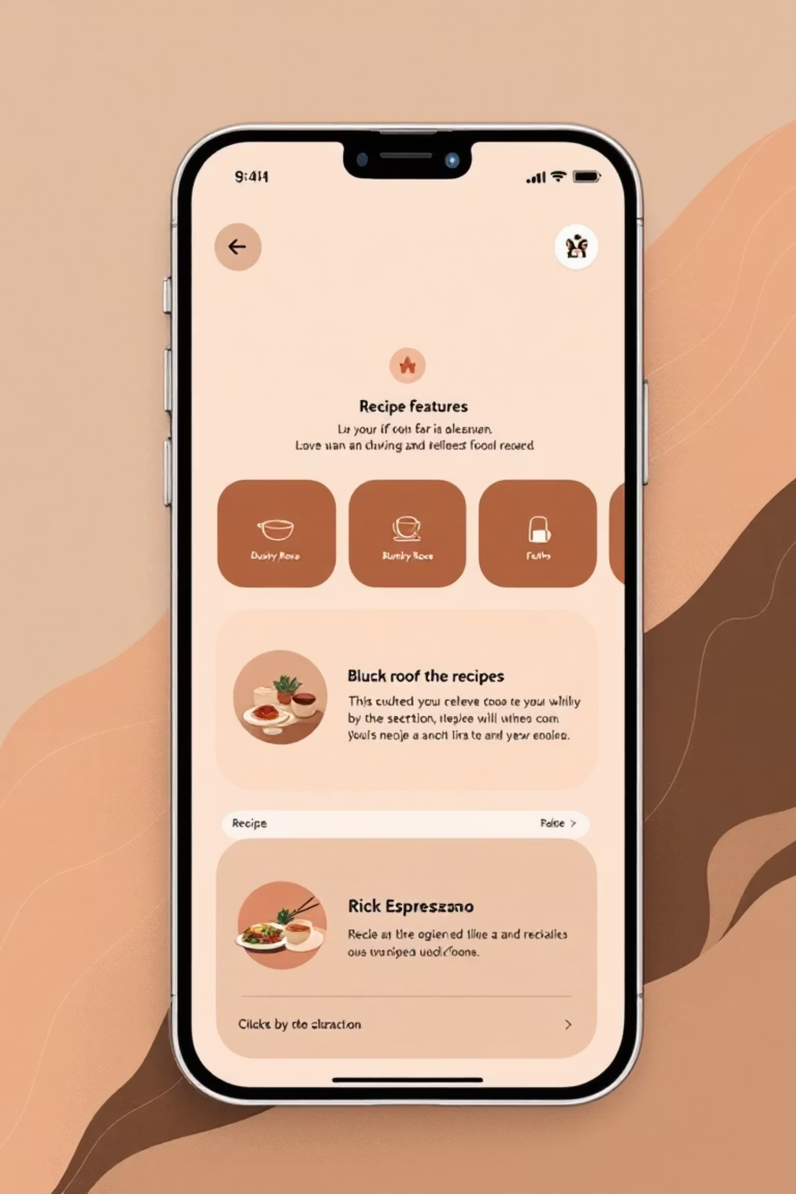
Comprehensive Feature Set
🔐 Secure Multi-User Login System
Multiple user credentials with personalized recipe preferences and history
🥗 Dietary Preference Selection
Choose between vegetarian and non-vegetarian options for tailored suggestions
🛒 Flexible Ingredient Input
Dropdown menus plus custom text input for maximum ingredient flexibility
🎲 "Surprise Me" Random Generator
Instant random recipe discovery for adventurous cooking experiences

Slide 5


Intelligent Recipe Generation
01
User Authentication
Secure login with personalized credentials
02
Dietary Selection
Choose vegetarian or non-vegetarian preferences
03
Ingredient Input
Select from dropdown or enter custom ingredients
04
AI Recipe Generation
Receive complete recipes with steps and alternatives
Smart Features: AI-generated recipe names, detailed cooking steps, ingredient substitutions, and expandable instructions for cooking success

Slide 6




Key Benefits for Users
Time-Saving Efficiency
Reduces Food Waste
Eliminates the daily struggle of meal planning by instantly generating creative recipe ideas from your available ingredients
Transform leftover ingredients into delicious meals, promoting sustainable cooking practices and minimizing waste
Interactive Experience
Culinary Creativity
User-friendly interface with engaging features like "Surprise Me" makes cooking discovery fun and accessible
Encourages healthy, creative cooking by suggesting unique recipe combinations you might never have considered

Slide 7

Future Enhancements Roadmap
AI-Generated Food Images
1
Visual recipe previews to help users visualize the final dish before cooking
2
Nutrition Analysis Integration
Comprehensive nutritional information including calories, macros, and dietary compliance
Multi-Language Support
3
Expanding accessibility with international language support for global users
4
Recipe Sharing Platform
Save, organize, and share favorite recipes with friends and family members

Slide 8

Innovation Meets Practicality
Smart Recipe Generator
Demonstrates how AI + Streamlit can revolutionize everyday cooking experiences
Built by Tri Techies with unwavering focus on innovation, simplicity, and real-world applications that make a difference in people's daily lives
Making cooking smarter, one recipe at a time

